Slide 1
Machine learning Model deployment
The Machine Learning Life Cycle
Model Deployment

Slide 2
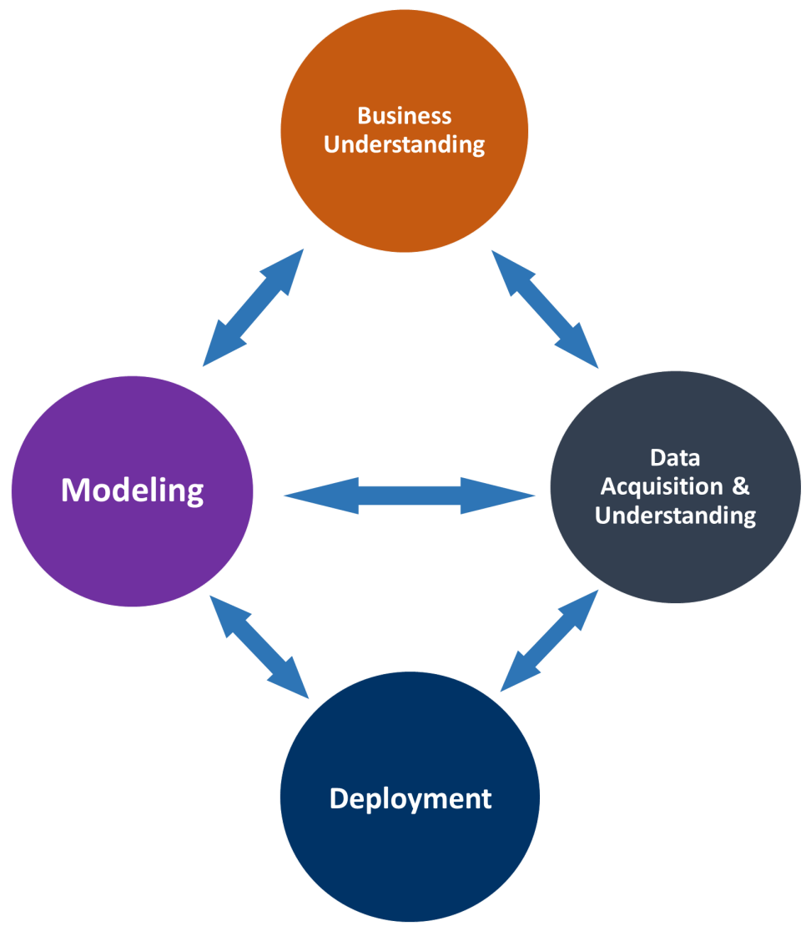
The Machine Learning Life Cycle (1/2)
 | Data acquisition Data source: On-premises vs Cloud / Database vs Files Pipeline: Streaming vs Batch / Low vs High frequency Environment: On-premises vs Cloud / Small vs Big Data Wrangling, Exploration & Cleaning: Structured vs Unstructured / Data validation and cleanup / Visualization Modeling Feature Engineering: Transforming, Binning and Feature selection Model Training: Algorithms, Ensemble, Parameter tuning Model Evaluation: Cross Validation, Model Reporting, A/B testing Deployment Backend: Scoring, Performance monitoring Frontend: Web service, Intelligent applications
Source 1: https://docs.microsoft.com/en-us/azure/machine-learning/team-data-science-process/lifecycle-modeling
Source 2: https://www.datarobot.com/wiki/machine-learning-life-cycle/
Source 3: https://machinelearningmastery.com/deploy-machine-learning-model-to-production/
Source 4: https://www.predictiveanalyticstoday.com/deployment-predictive-models/

Slide 3
The Machine Learning Life Cycle (2/2)
Define project objectives
Specify business problem
Define unit of analysis and prediction target
Prioritize modeling criteria
Consider risks and success criteria
Acquire and explore data
Find appropriate data
Conduct exploratory data analysis
Find and remove target leakage
Feature engineering
Model data
Variable selection
Build candidate models
Model validation and selection
Interpret and communicate
Interpret model
Communicate model insights
Implement, document and maintain
Set up batch and API prediction system
Document modeling process for reproducibility
Create model monitoring and maintenance plan

Slide 4
Model Deployment (1/2)
Predictive model deployment provides the option to deploy analytical results in to every day decision making process, for automating the decision making process.
There are many challenges in deployment as many organizations lack integrated technical infrastructure to deploy the model between different departments and business units.
These challenges in deployment also include data in different data sources, requirement to integrate the model in to different applications.
Predictive model deployment and monitoring
Validate the model
Choose the model
Score the model
Integrate with reporting
Integrate with application
Monitor
Improve the models
Functionalities of software
Create, delete, and merge models
Extract and import models in formats such as spar file and PMML format. Predictive Model Markup Language (PMML) is an XML language for statistical and data mining models which make it easy to move models between different applications and platforms.
The deployed predicted models are monitored for model performance.
Generally the deployed models are repeatedly published in a production environment and the model performance reduces over the period of time.
Organizations have process built in to systematically detect the performance reduction in the deployed models to find and obsolete models and to build new ones.
After the model is validated, the model is moved to production by implementing a scoring system where the model is applied to new data that does not have a dependent variable.
For the models which has impact to operational business decisions, such as an application score model or cross sell model, the implementation system is generally an operational enterprise planning system or a transaction handling system.

Slide 5
Model Deployment (2/2)
5 Machine Learning Model Deployment Best Practices
Specify Performance Requirements
You need to clearly spell out what constitutes good and bad performance. This maybe as accuracy or false positives or whatever metrics are important to the business.
Performance requires are important. Without them, you will not be able to setup the tests you will need to determine if the system is behaving as expected.
Separate Prediction Algorithm From Model Coefficients
You may have used a library to create your predictive model. It is good practice to separate the algorithm that makes predictions from the model internals. That is the specific coefficients or structure within the model learned from your training data.
Implement the prediction algorithm and serialize your model coefficients
Develop Automated Tests For Your Model
You need automated tests to prove that your model works as you expect. They ensure the software has not regressed in its behavior in the future as we make changes to different parts of the system.
Gathering outlier and interesting cases from operations over time that produce unexpected results (or break the system). These should be understood and added to the regression test suite.
Develop Back-Testing and Now-Testing Infrastructure
The model will change, as will the software and the data on which predictions are being made. Automate the evaluation of the production model to efficiently back-test changes to the model on historical data and determine if there is an improvement or not.
Run the current operational model to baseline performance. Run new models, competing for a place to enter operations. The idea is to get an early warning that the production model may be faltering.
Challenge Then Trial Model Updates
A smaller and more manageable change would be to the model coefficients. For example, perhaps you set up a grid or random search of model hyperparameters that runs every night and spits out new candidate models.
Test the model and be highly critical. Give a new model every chance to slip up. Evaluate the performance of the new model using the Back-Test and review the results carefully. Evaluate the change using the regression test, as a final automated check.

